Slide 1
MedLearn AI
AI-Driven Clinical Assessment Platform For Healthcare Workforce

Slide 2
The Pain points
Content Creation : In-House or 3rd party
Generic Content
Competitive Pressure
Manual competency Mapping
Content Update Lag
No Evidence Based Citation Integration
Less Integrations With Cloud Storage
Speed and Scalability

Slide 3
Problem Overview
As hospitals expand or acquire new facilities, they need to rapidly scale training content for new staff, new departments, and new specialties.
Manual content creation doesn't scale efficiently (USERS REVIEWS FROM INTERNET)
HLX delivers exceptional personalized pathways (Jane AI – 98.61correlation with human validation) but the content creation is still manual.
When clinical guidelines change , updating all affected training modules is slow
Educators must search for relevant studies, verify currency, extract key findings, and format citations
competitors like Sana Learn and Docebo now have AI content generation
Hospitals don't want generic training—they want training on THEIR protocol, THEIR medication formulary,THEIR Epic workflow within Less time

Slide 4
The Solution
Content Velocity and Cost
Evidence Based Quality
Document Upload & RAG
Personalization via Difficulty levels
Comprehensive coverage on topics
Micro-Modules
Skills/ competency graphs
More Advanced Adaptivity
Smarter Autoring Helpers

Slide 5
MedLearn AI Features
AI Content Generation(Scenario Based)
PubMed Based Evidence
Supports All type of Files
Hospital policy RAG
Skills Analytics
Micro-Modules
Adaptive Learning
Language Translation
NCLEX- NGN style based questions

Slide 6
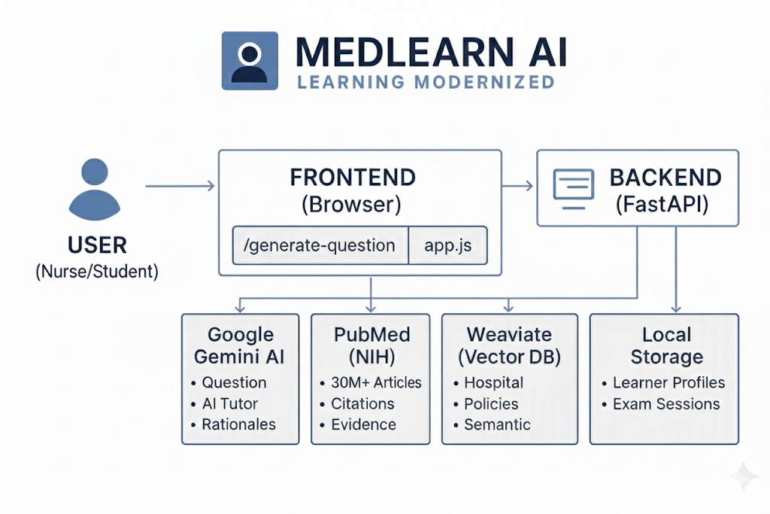

Slide 7
MedLearn Expanded
Semantic search across indexed hospital documents using Weaviate database enables context-aware question generation from specific protocol sections
Combines uploaded hospital protocols with PubMed evidence to generate questions
Three assessment modes (Practice, Timed, Adaptive) with real-time difficulty adjustment based on learner performance pattern
Tracks performance at skill level and topic level, not just completion rates
Educators switch tone (“student nurse”, “experienced RN”) and reading level (plain vs technical) for scenarios and explanations.
Chat interface Uses your indexed documents + PubMed to Answer learners questions - AI chatbot
Breaks complex topics into 5-10 minute modules consumable during clinical breaks, respecting healthcare workers' limited dedicated study time

Slide 8
Future Scope &Improvements
Knowledge Retention Proxy
Gap Driven Recommendations
Gamification Layer
No-Go Topic lists
Social and Peer Learning
Natural Language Processing
Multi-Lingual Semantic Support
Fully Featured Mobile Experience
Even More use of AI (AGENTIC AI & RAG)

Slide 9
Ethics & Research
This analysis was conducted independently using only publicly available sources including official company websites, Health stream webinars, published Research , Blogs and industry analysis reports. No confidential or proprietary information was accessed. All materials analyzed are publicly accessible and properly cited, with supporting documentation and screenshots included in the research appendix.
LINK :
https://docs.google.com/document/d/1jXevhQvqXo9FeRdtgBNSPEFHaVD4G4Lg/edit?usp=sharing&ouid=112319365804890427156&rtpof=true&sd=true

Slide 10

Thank you
Revanth Putta
M.S in AI | ongoing
University of North Texas (UNT)
(940) 514 6696
Revanthputta@my.unt.edu

